Slide 1
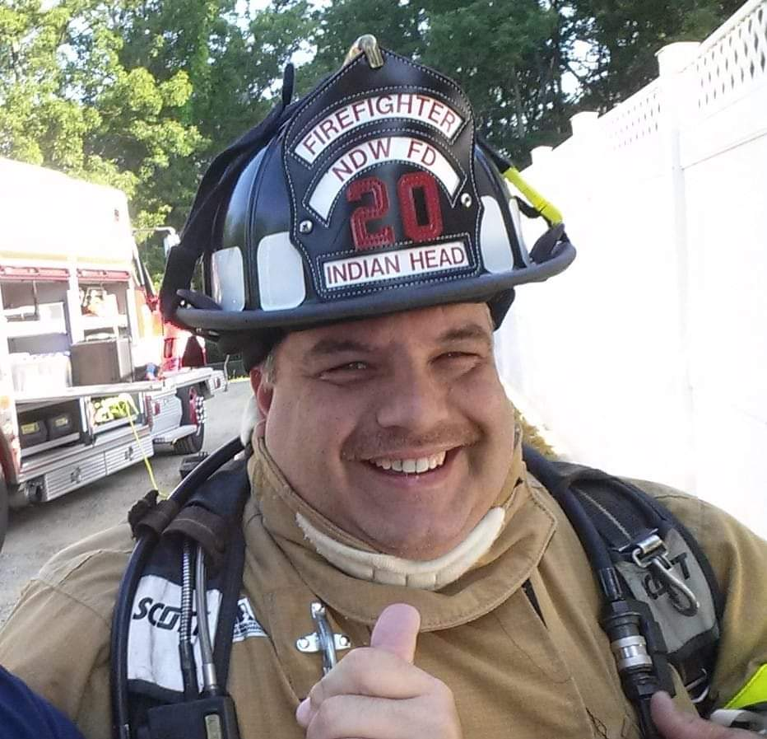
Memorial Wreath Laying
In Remembrance of the
2nd Anniversary of the LODD of
FF Bryan “Hammy” Hamilton
Sunday January 1, 2023
1000hrs
Trinity Memorial Gardens
Waldorf, MD

